Slide 1


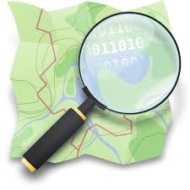

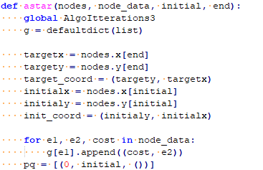
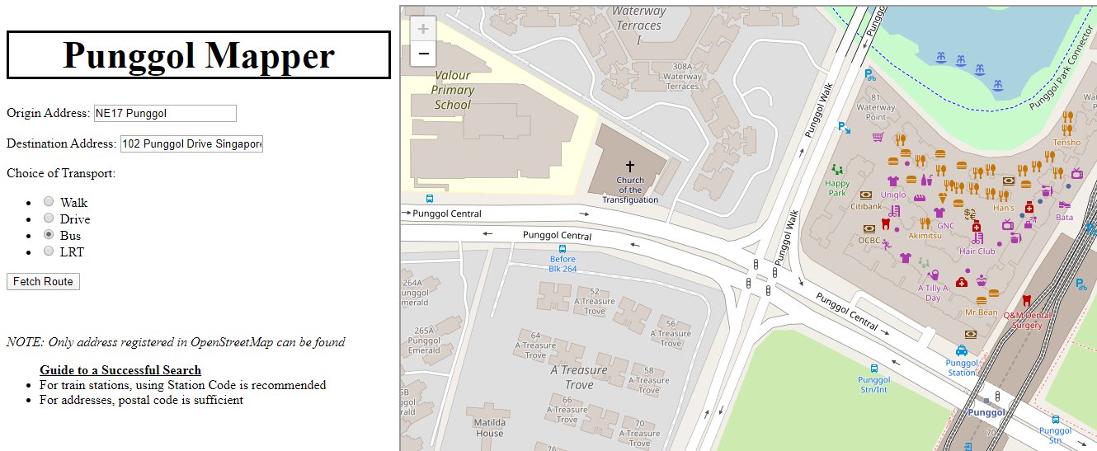
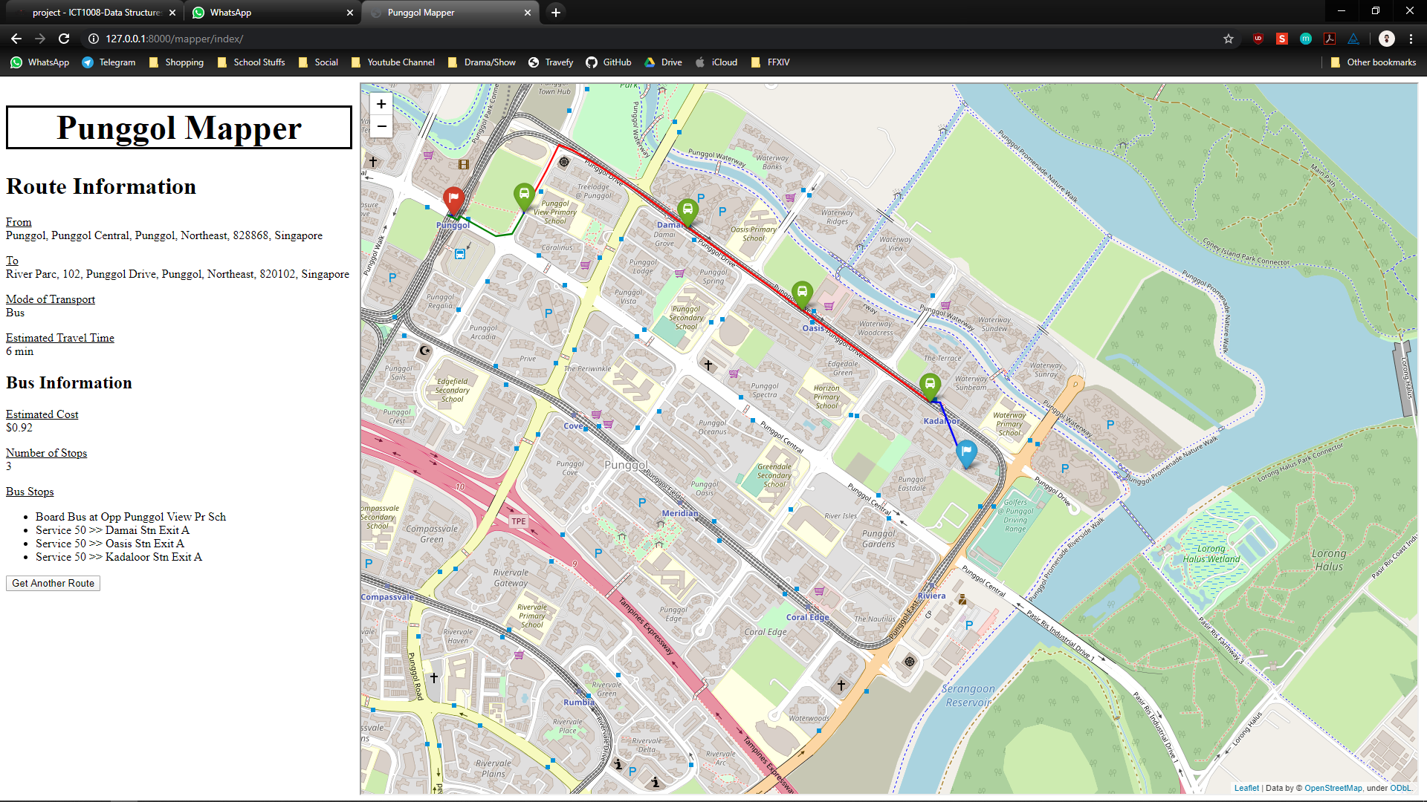
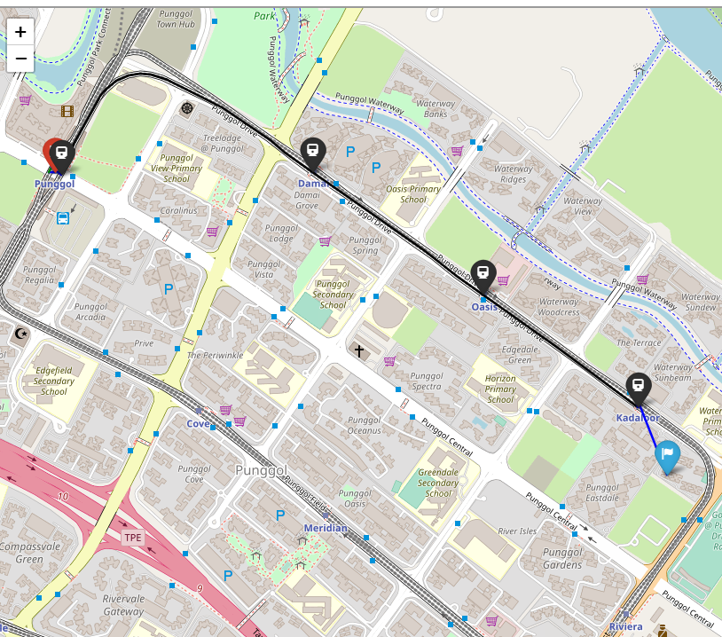
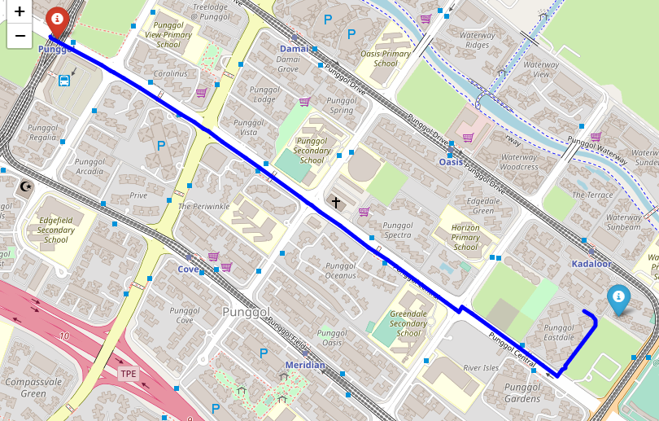
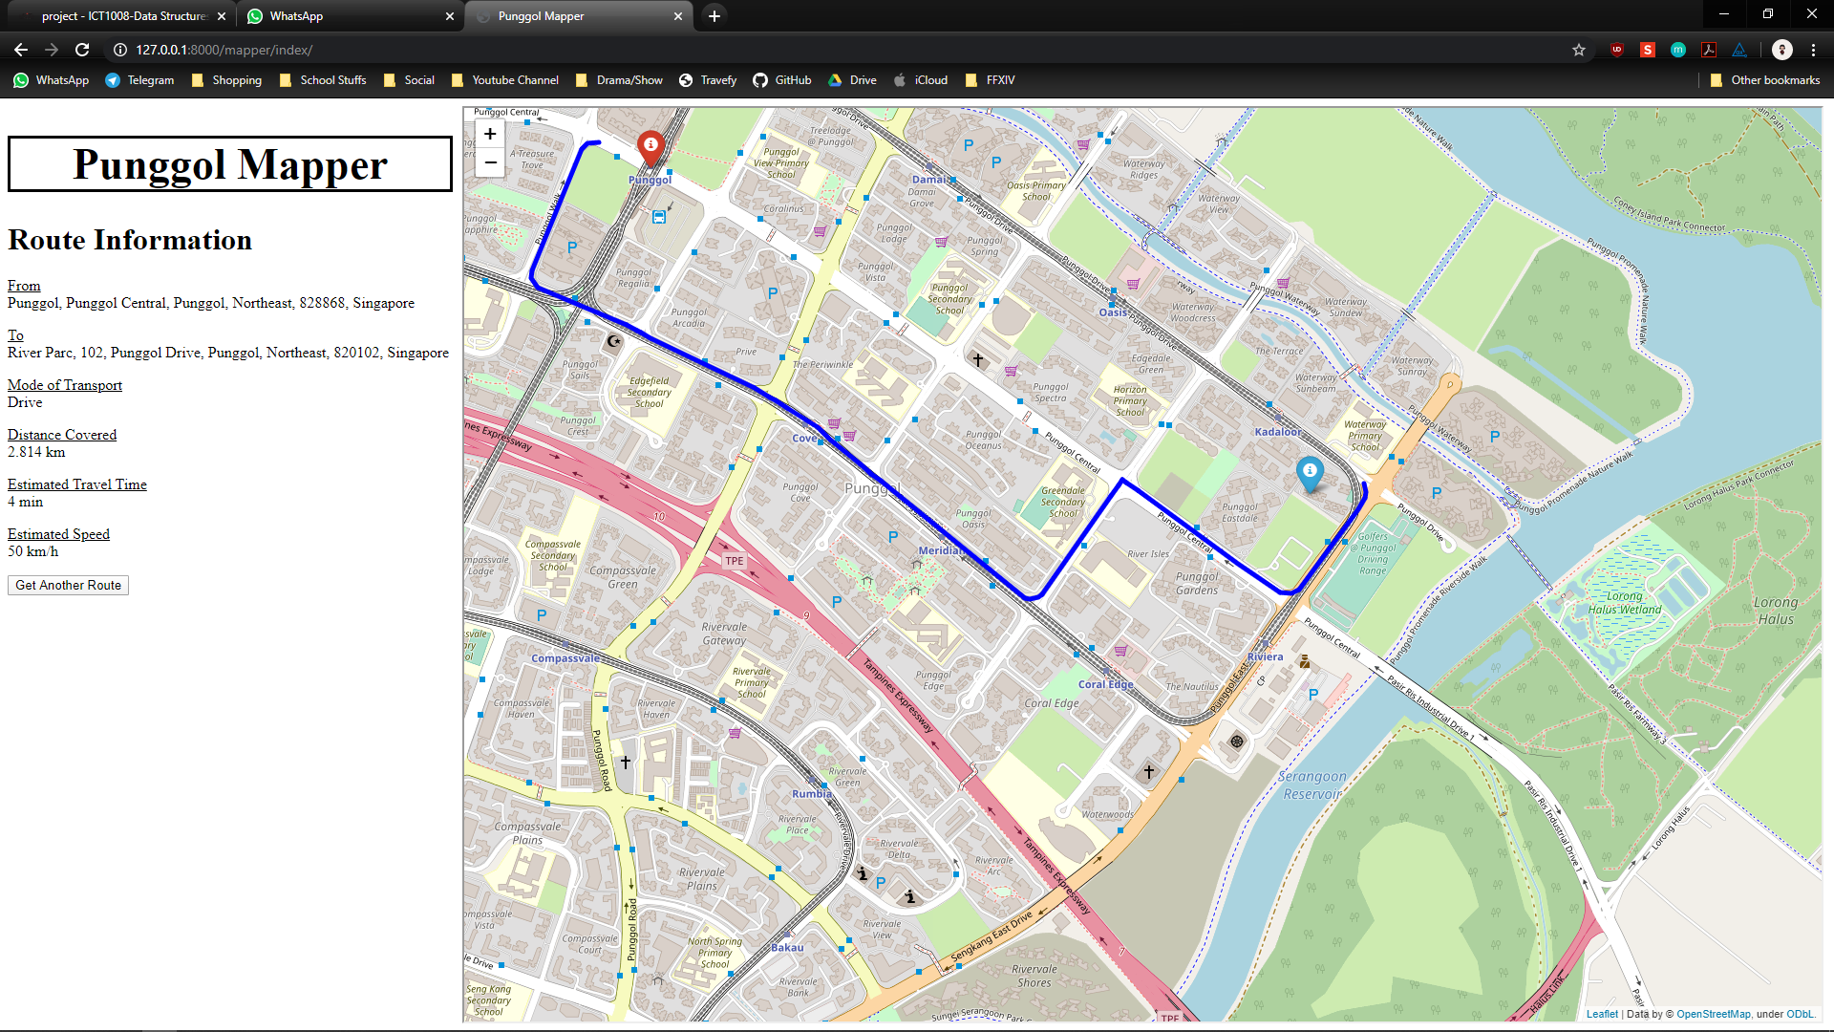
Faculty: Soh Cheng Lock, Donny
Student: Nicholas Koh Wei Xuan | Raynold Tan Yong Ren
Lim Quan-Kun Nicholas | Tan Kae Chuan
Lee Khai Liang Eugene
Routing Punggol Network with OSMnx
Goal
Frameworks Used
The goal of this path finder is to provide ease to residents of Punggol in commuting, both easily and swiftly. ‘Punggol Mapper’ ensures that the end users would be able to commute to their destination while traveling at the shortest distance, saving both time and energy moving around.
With SIT moving to its main campus in Punggol sometime in 2023, this path finder aims to help our students to travel around Punggol without difficulties, providing the necessary information needed to travel.
Routing Specifics
OSMnx – Python for Street Networks
(https://github.com/gboeing/osmnx)
Folium – Python Data, leaflet.js Maps
(https://python-visualization.github.io/folium/)
Visualisation
Django – Python High-Level Web Framework
(https://www.djangoproject.com/)
So, how do we ensure that we provide the best to our users?
The answer to that is.. by utilising popular useful algorithms! The A* Search Algorithm, which is widely used by famous path finder application namely, Google Maps. This algorithm can be used to determine the shortest path for driving, riding, walking and even cycling!
Another such algorithm that we apply is the Breadth First Search Algorithm. This algorithm is used to route the shortest path for when public transport is the mode of traveling. Why so you asked? That is because buses and trains have predefined destinations to follow!
Algorithm
^ Exclusive sneak peak to our implementation
Demostration
Let’s say you live in Punggol District in the following location: 102 Punggol Drive Singapore 820102
So how do you head home from NE17 Punggol Station?
Step 1: Key in the necessary details
Step 2: Profit!
By Bus
By LRT
By Walking
By Driving
Features
Bus & LRT
Displays which Service to take
Displays all the Stations/Bus Stops in order
Displays Cost of Travel
Displays Estimated Travel Time
Walking & Driving
Assumes Walking Speed: 5 km/h & Driving Speed 50 km/h
Displays Estimated Travel Time
Displays Total Distance Covered

Slide 2
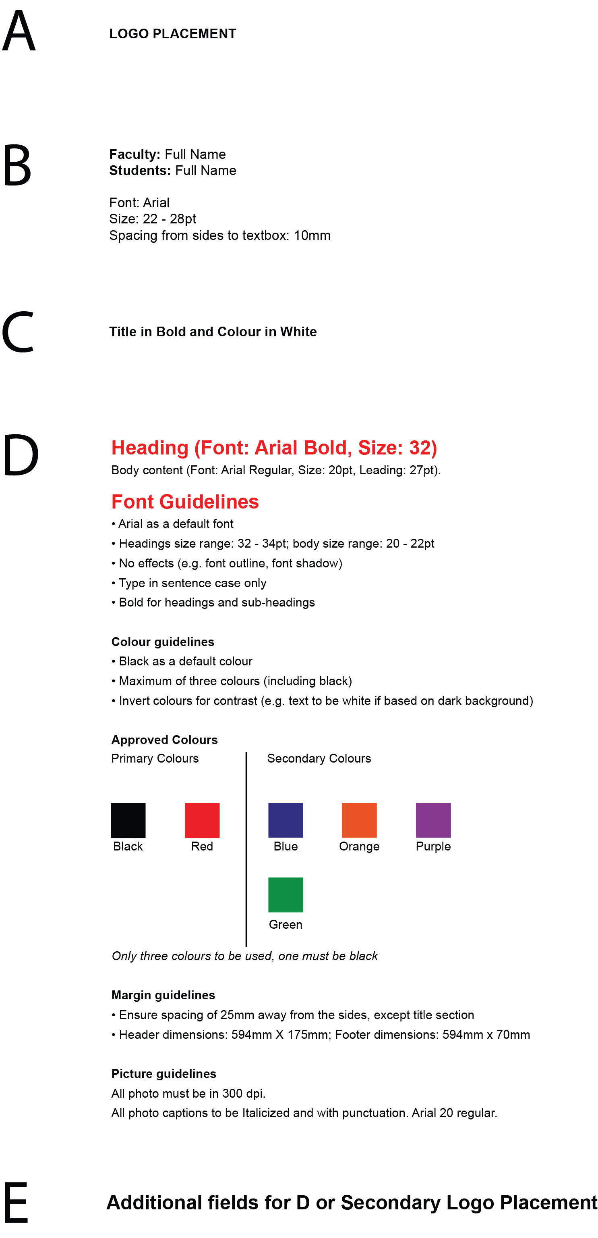
Notes:
A – LOGO PLACEMENT
B – Names
Faculty: Full Name
Students: Full Name
Font: Arial
Size: 22 - 28pt
Spacing from sides to textbox: 10mm
C – Names
Title in Bold and Colour in White
D – Content
Heading (Font: Arial Bold, Size: 32)
Body content (Font: Arial Regular, Size: 20pt, Leading: 27pt).
Font Guidelines
• Arial as a default font
• Headings size range: 32 - 34pt; body size range: 20 - 22pt
• No effects (e.g. font outline, font shadow)
• Type in sentence case only
• Bold for headings and sub-headings
Colour guidelines
• Black as a default colour
• Maximum of three colours (including black)
• Invert colours for contrast (e.g. text to be white if based on dark background)
Approved Colours
Only three colours to be used, one must be black
Margin guidelines
• Ensure spacing of 25mm away from the sides, except title section
• Header dimensions: 594mm X 175mm; Footer dimensions: 594mm x 70mm
Picture guidelines
All photo must be in 300 dpi.
All photo captions to be Italicized and with punctuation. Arial 20 regular.
Primary Colours: Black Red
Secondary Colours: Green Blue Orange Purple
E - Additional fields for D or Secondary Logo Placement

Slide 3
Faculty: Soh Cheng Lock, Donny
Student: Nicholas Koh Wei Xuan | Raynold Tan Yong Ren
Lim Quan-Kun Nicholas | Tan Kae Chuan
Lee Khai Liang Eugene
Routing Punggol Network with OSMnx
Goal
Frameworks Used
The goal of this path finder is to provide ease to residents of Punggol in commuting, both easily and swiftly. ‘Punggol Mapper’ ensures that the end users would be able to commute to their destination while traveling at the shortest distance, saving both time and energy moving around.
With SIT moving to its main campus in Punggol sometime in 2023, this path finder aims to help our students to travel around Punggol without difficulties, providing the necessary information needed to travel.
Routing Specifics
OSMnx – Python for Street Networks
(https://github.com/gboeing/osmnx)
Folium – Python Data, leaflet.js Maps
(https://python-visualization.github.io/folium/)
Visualisation
Django – Python High-Level Web Framework
(https://www.djangoproject.com/)
So, how do we ensure that we provide the best to our users?
The answer to that is.. by utilising popular useful algorithms! The A* Search Algorithm, which is widely used by famous path finder application namely, Google Maps. This algorithm can be used to determine the shortest path for driving, riding, walking and even cycling!
Another such algorithm that we apply is the Breadth First Search Algorithm. This algorithm is used to route the shortest path for when public transport is the mode of traveling. Why so you asked? That is because buses and trains have predefined destinations to follow!
Algorithm
^ Exclusive sneak peak to our implementation
Demonstration
Let’s say you live in Punggol District in the following location: 102 Punggol Drive Singapore 820102
So how do you head home from NE17 Punggol Station?
Step 1: Key in the necessary details
Step 2: Profit!
By Bus
By LRT
By Walking
By Driving
Features
Bus & LRT
Displays which Service to take
Displays all the Stations/Bus Stops in order
Displays Cost of Travel
Displays Estimated Travel Time
Walking & Driving
Assumes Walking Speed: 5 km/h & Driving Speed 50 km/h
Displays Estimated Travel Time
Displays Total Distance Covered

